Slide 2
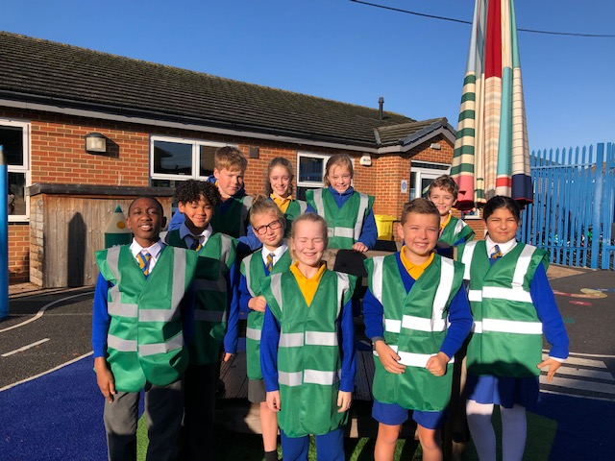
We are St Edmund’s
Anti Bullying Ambassadors
We are the [INSERT YOUR SCHOOLS NAME] Anti-Bullying Ambasadors
Space to insert photo of
ABAs/school logo
Notes:
Say: “Anti-Bullying Ambassadors are trained passionate young people who will stand up to bullying behaviour and believe they can change things for the better. Anti-Bullying Ambassadors believe that bullying behaviour is not a normal part of life. They support others and take a stand to shape attitudes and change these behaviours. They are a pillar of support, look out for others and are a strong youth voice for the school community.”

Slide 3
Notes:
Say, there are three important parts to this definition
1. Repeated – it must happen more than once for it to be considered bullying behaviour. An example – someone calls me a horrible name in school. This is the first time they have done this to me. I’m really upset by what they’ve said. (Ask YP to vote by raising their hands if they think it is bullying behaviour). This isn’t bullying behaviour because it isn’t repeated, it hasn’t happened more than once. I’ve still been upset by what has been said and should seek support from a teacher to address the behaviour, but it’s not bullying behaviour.
2. Negative behaviour – it must be some sort of negative behaviour and we’re going to look at the different types of negative behaviour on the next slide.
3. Intended – this means that it must be done on purpose knowing that it’s going to make someone feel upset, uncomfortable or unsafe. If someone does something by accident or isn’t aware of the impact of their actions, then this isn’t bullying behaviour. Again, this doesn’t mean that it’s ok but they need to be made aware of what they are doing.

Slide 5
Notes:
Say, in order to understand what being an upstander to bullying behaviour looks like, it can be useful to think about what the opposite of an Upstander is. This is called being a bystander.
BYSTANDER
Say, for example, you know that someone in your class is always picked on at play time by an older pupil, but you ignore the situation and just get on with your break time.
UPSTANDER
Say, for example, in our previous example, you know that someone in your class is always picked on at play time by an older pupil; instead of just ignoring the situation, you ask the target if they are ok and how you can help. Or you report the bullying behaviour to a member of staff in school. This is how simple and powerful being an upstander can be!

Slide 6
Notes:
1. Report – if you know of bullying behaviour happening, tell a teacher about it. They will be able to help. If you see bullying behaviour happening online such as nasty comments, you can report them anonymously (people won’t know it was you) to the site. They can then deal with them by removing the comments.
2. Offer support – Like in the previous example, offering your support and asking if the target of the bullying behaviour is ok is such a powerful and simple thing you can do. They might be feeling alone and low because of the bullying behaviour – your support and kindness will mean a lot to them.
3. Be the change you want to see – if you want to make sure that your school is a safe and welcoming place for all, then make sure that you are demonstrating kind and inclusive behaviour. If you don’t think something is right, don’t join in or laugh along. Challenge negative behaviour if it is safe to do so.

